Slide 1


Slide 2

EXPLORING CANCER TRENDS IN INDIA
A STATISTICAL APPROACH TO GENDER AND ZONAL VARIATIONS

Slide 3
INDEX
S. No. | Title
1 | Introduction
2 | Objective
3 | Methodology
4 | Graphical Representation
5 | Hypothesis
6 | Results and Discussions
7 | Limitation
8 | Conclusion
9 | References

Slide 4
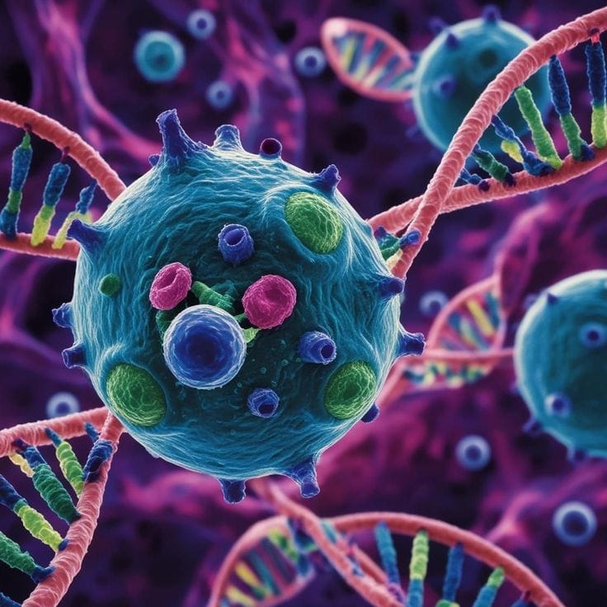
INTRODUCTION
India is a fast-growing economy experiencing rapid demographic and lifestyle changes. These shifts are starting to significantly affect the nation’s disease patterns.
As the economy develops, changes in diet, exposure to the environment, access to healthcare, and population structure are reshaping the cancer risk landscape in India.
Cancer is not just a disease—it is a complex societal challenge influenced by culture, access, and awareness. Population growth and improved diagnostic facilities have also contributed to higher cancer detection rates.

Slide 5
Cancer distribution in India is highly varied, meaning some areas have much higher incidence rates than others.
Understanding these trends, especially regarding gender, age and zonal differences, is crucial for developing prevention strategies, improving early detection, and informing healthcare policies.
Its trajectory requires more than medical knowledge; it demands a statistical journey through India’s diverse landscape. By exploring zonal variation and gender disparities, this study reveals critical gaps and patterns that can guide future prevention strategies and healthcare planning.

Slide 6

OBJECTIVE OF STUDY
To examine the spatial distribution of cancer incidence across various zones in India.
To assess whether geographical zone of residence influences the probability of individuals being diagnosed cancer positive.
To analyze whether gender plays a role in the number of cancers in India.
To analyze the age group most at risk of developing cancer.

Slide 7

METHODOLOGY
Population Definition
The study population is derived from the National Centre for Disease Informatics and Research (NCDIR) dataset, covering cancer incidence across six zones of India: North East, North, South, East, West, and Central.
Data Collection
This research relies entirely on secondary data sourced from NCDIR, a nationally recognized government authority. The dataset is systematically collected, validated, and standardized, providing reliable and credible information for epidemiological and public health analysis.

Slide 8
Understanding the Dataset
The dataset is hierarchically structured by zone, state, gender, and age group, enabling detailed regional and demographic comparisons.
Statistical Methodology
The study employs correlation analysis to assess relationships between variables and simple linear regression to examine the impact of predictors on cancer incidence. These techniques help quantify associations, trends, and predictive relationships within the data.
Hypothesis Testing (Chi-Square Test)
Chi-square tests are used to examine whether cancer incidence differs significantly by gender and geographic zone. The test compares observed and expected frequencies to determine whether variations in cancer cases occur due to chance or indicate statistically significant associations.

Slide 9
GRAPHICAL REPRESENTATION

Slide 10
Gender most at risk of developing cancer
The nearly equal distribution of cancer cases between males and females
This balance highlights the need for equitable access to cancer screening, diagnostic and treatment services for both men and women.
Since neither gender is disproportionately affected, public health interventions should be designed to address both groups equally through awareness, prevention and care initiatives.
Furthermore, the balanced gender ration suggests that factors such as age, geographic zone, environmental exposure, lifestyle and socio-economic conditions.
Gender | Total
Males | 152100186
Females | 142916569

Slide 11
Zone with the highest incidence of cancer cases in India
Zones | Total
Central Zone | 41254260
East Zone | 89541595
North East Zone | 54540323
North Zone | 157220198
South Zone | 103419407
West Zone | 223443845
The West Zone bears the highest cancer burden,
North and South Zones, indicating a concentration of cases in these regions.
The North Zone shows a moderate level of incidence, while the East Zone records substantially fewer cases.
The Central Zone reports the lowest cancer burden among the zones.
Overall, the findings highlight uneven distribution of cancer cases, with certain zones experiencing disproportionately higher prevalence underscoring the need for zone specific health planning and resource allocation.

Slide 12
Age group highly prone to cancer
Age Group | Total
00-04 | 23456241
05-09 | 24373027
10-14 | 25635098.5
15-19 | 26876491
20-24 | 30442587
25-29 | 29320648.5
30-34 | 25468697
35-39 | 23097636
40-44 | 19860908
45-49 | 17065502.5
50-54 | 13595898
55-59 | 10586263.5
60-64 | 8912146
65-69 | 5981238
70-74 | 4558818.5
75+ | 5785554.5
Cancer incidence increases steadily from early childhood to young adulthood, peaking in the 20-24 age group.
High case numbers persist through the 25-29 and 30-34 age groups, after which a gradual decline is observed.
From the 40-44 age group onward, the decrease becomes more pronounced.
Overall, the findings indicate a disproportionately higher cancer burden among younger and middle-aged adults, highlighting the importance of targeted awareness programs, early screening and preventive innervations focused on younger age groups.
Table 1.8: Age wise distribution of Cancer Cases
Fig 1.8: Graphical Representation of Age wise distribution of Cancer Cases

Slide 13
Region wise gender analysis of cancer patients
Zones | Males | Females
Central Zone | 4280917 | 3969935
East Zone | 9270946 | 8637373
North East Zone | 27541445 | 26998878
North Zone | 32929570 | 29958509
South Zone | 31641265 | 30410379
West Zone | 46436043 | 42941495
Overall, male cases are marginally higher than female cases in most zones
The Central and East Zones report relatively lower-case counts, with the East Zone uniquely showing slightly higher female cases.
Cancer incidence rises sharply in the North-East, North and South Zones where both genders record high and closely aligned case number of cases
Overall, the findings emphasize the need for zone-specific cancer surveillance and strengthened healthcare infrastructure, particularly in high-burden regions such as the North, South and West Zones.
Table 2.0: Gender wise distribution of Cancer cases in every zone
Fig 2.0: Graphical Representation of Gender wise distribution of Cancer cases in every zone

Slide 14
HYPOTHESIS

Slide 15
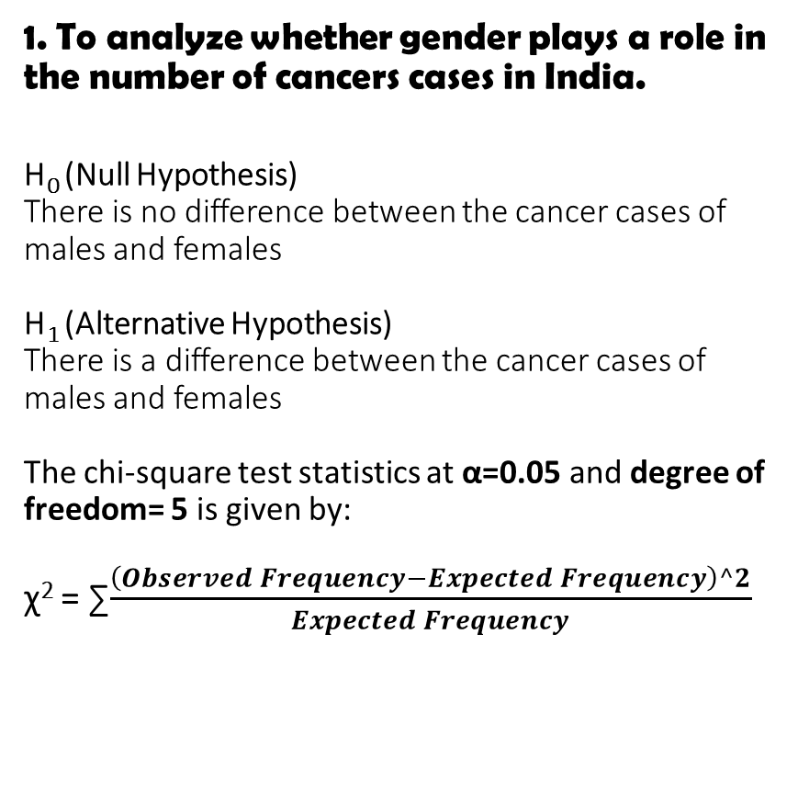
1. To analyze whether gender plays a role in the number of cancers cases in India. H₀ (Null Hypothesis) There is no difference between the cancer cases of males and females H₁ (Alternative Hypothesis) There is a difference between the cancer cases of males and females The chi-square test statistics at α=0.05 and degree of freedom= 5 is given by: ꭓ² = ∑$\frac{\left(Observed Frequency−Expected Frequency\right)^2}{Expected Frequency}$
Observed Frequency
Zones | Males (X) | Females (Y) | Total
Central Zone | 4280917 | 3969935 | 8250852
East Zone | 9270946 | 8637373 | 17908319
North East Zone | 27541445 | 26998878 | 54540323
North Zone | 32929570 | 29958509 | 62888079
South Zone | 31641265 | 30410379 | 62051644
West Zone | 46436043 | 42941495 | 89377538
Total | 152100186 | 142916569 | 295016755
Table 2.2: Observed Frequency of number of cancer cases among males and females in every zone
Expected Frequency
Zones | Males (X) | Females (Y) | Total
Central Zone | 4253846.951 | 3997005.05 | 8250852
East Zone | 9232894.758 | 8675424.24 | 17908319
North East Zone | 28119058.09 | 26421264.9 | 54540323
North Zone | 32422865.32 | 30465213.7 | 62888079
South Zone | 31991629.07 | 30060014.9 | 62051644
West Zone | 46079891.82 | 43297646.2 | 89377538
Total | 152100186 | 142916569 | 295016755
Table 2.3: Expected Frequency of number of cancer cases among males and females in every zone

Slide 16
Using the formula the value we calculate the value of χ² calculated = 55121.49618 Using the χ² table, we get: χ² tabulated= 11.07 Conclusion: Since χ² tabulated is less than χ² calculated that is 11.07 < 55121.49618. Thus, we reject the null hypothesis (H₀). Hence, there is a difference between the cancer cases of males and females.
Class | Frequency |  | Observed - Expected | (Observed - Expected) ^2/Expected
 | Observed | Expected
Central Zone Male | 4280917 | 4253846.95 | 27070.04863 | 172.2646681
Central Zone Female | 3969935 | 3997005.05 | -27070.04863 | 183.3341525
East Zone Male | 9270946 | 9232894.76 | 38051.24171 | 156.8193978
East Zone Female | 8637373 | 8675424.24 | -38051.24171 | 166.8963909
North East Zone Male | 27541445 | 28119058.1 | -577613.0949 | 11865.15161
North East Zone Female | 26998878 | 26421264.9 | 577613.0949 | 12627.5895
North Zone Male | 32929570 | 32422865.3 | 506704.6848 | 7918.783091
North Zone Female | 29958509 | 30465213.7 | -506704.6848 | 8427.632916
South Zone Male | 31641265 | 31991629.1 | -350364.0653 | 3837.096823
South Zone Female | 30410379 | 30060014.9 | 350364.0653 | 4083.663249
West Zone Male | 46436043 | 46079891.8 | 356151.185 | 2752.690199
West Zone Female | 42941495 | 43297646.2 | -356151.185 | 2929.574185
Table 2.4: χ² calculation

Slide 17
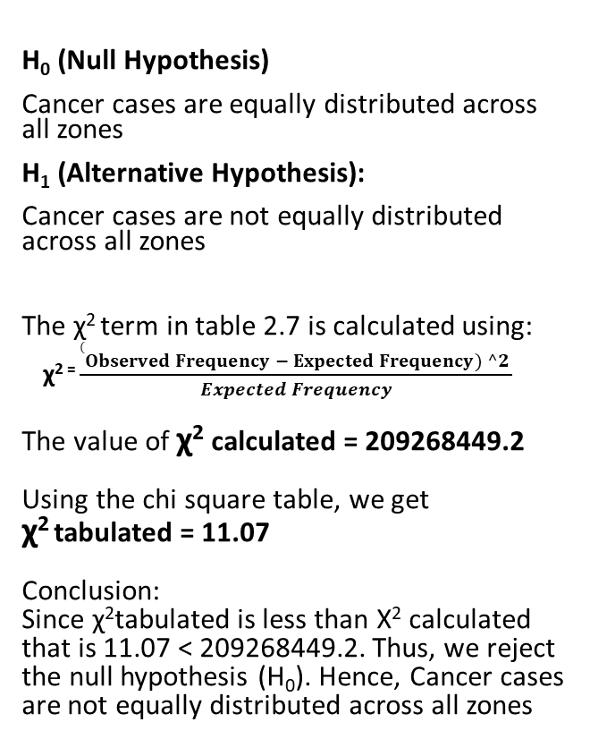
2. To assess whether geographical zone of residence influences the probability of individuals being diagnosed cancer positive.
Zones | Total
Central Zone | 41254260
East Zone | 89541595
North East Zone | 54540323
North Zone | 157220197.5
South Zone | 103419406.7
H₀ (Null Hypothesis)
Cancer cases are equally distributed across all zones
H₁ (Alternative Hypothesis):
Cancer cases are not equally distributed across all zones
The χ² term in table 2.7 is calculated using:
χ² ⁼ $\frac{(Observed Frequency − Expected Frequency) ^2 }{Expected Frequency}$
The value of χ² calculated = 209268449.2
Using the chi square table, we get
χ² tabulated = 11.07
Conclusion:
Since χ²tabulated is less than Χ² calculated that is 11.07 < 209268449.2. Thus, we reject the null hypothesis (H₀). Hence, Cancer cases are not equally distributed across all zones
Table 2.6: Zonal representation of total cancer cases
Zones | Total | Expected | Chi Term
Central Zone | 41254260 | 111569937.9 | 44315652.1
East Zone | 89541595 | 111569937.9 | 4349270.95
North East Zone | 54540323 | 111569937.9 | 29151015.4
North Zone | 157220197.5 | 111569937.9 | 18678384.6
South Zone | 103419406.7 | 111569937.9 | 595421.67
West Zone | 223443845 | 111569937.9 | 112178705
Table 2.7: χ² calculation

Slide 18
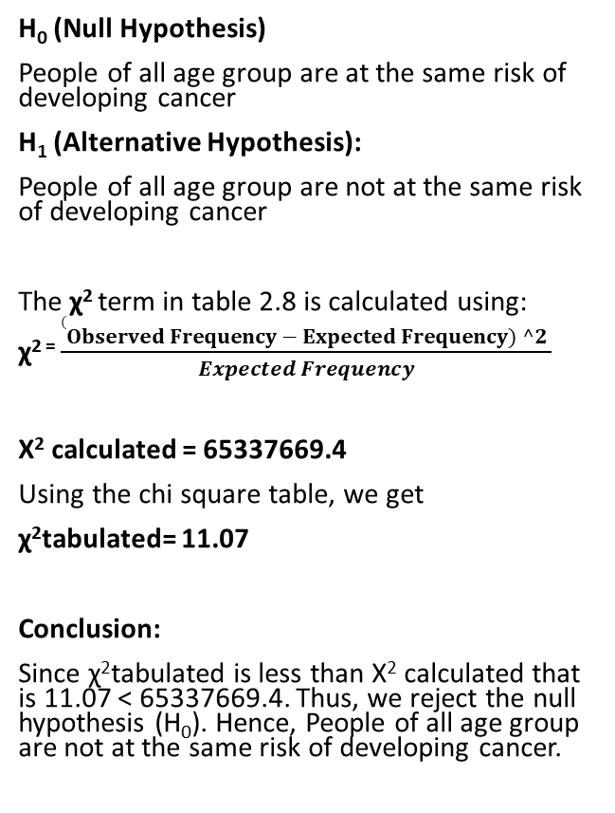
3. To analyze the age group most at risk of developing cancer.
Age Group | Total | Expected | Chi Term
00-04 | 23456241 | 18438547.2 | 1365468
05-09 | 24373027 | 18438547.2 | 1910023
10-14 | 25635098.5 | 18438547.2 | 2808809
15-19 | 26876491 | 18438547.2 | 3861416
20-24 | 30442587 | 18438547.2 | 7814985
25-29 | 29320648.5 | 18438547.2 | 6422422
30-34 | 25468697 | 18438547.2 | 2680418
35-39 | 23097636 | 18438547.2 | 1177268
40-44 | 19860908 | 18438547.2 | 109721.8
45-49 | 17065502.5 | 18438547.2 | 102245.1
50-54 | 13595898 | 18438547.2 | 1271860
55-59 | 10586263.5 | 18438547.2 | 3343992
60-64 | 8912146 | 18438547.2 | 4921880
65-69 | 5981238 | 18438547.2 | 8416311
70-74 | 4558818.5 | 18438547.2 | 10448050
75+ | 5785554.5 | 18438547.2 | 8682800
H₀ (Null Hypothesis)
People of all age group are at the same risk of developing cancer
H₁ (Alternative Hypothesis):
People of all age group are not at the same risk of developing cancer
The χ² term in table 2.8 is calculated using:
χ² ⁼ $\frac{(Observed Frequency − Expected Frequency) ^2 }{Expected Frequency}$
Χ² calculated = 65337669.4
Using the chi square table, we get
χ²tabulated= 11.07
Conclusion:
Since χ²tabulated is less than Χ² calculated that is 11.07 < 65337669.4. Thus, we reject the null hypothesis (H₀). Hence, People of all age group are not at the same risk of developing cancer.

Slide 19

RESULT AND DISCUSSION
Strengthening Government Role in Cancer Control
Government agencies should improve cancer surveillance system
The government should increase funding for cancer prevention
Nationwide campaigns should educate people about cancer risk factors
Enhancing Healthcare Infrastructure and Accessibility
High-burden regions should have more oncology centers
Financial assistance programs and insurance coverage should be improved to lessen the economic burden of cancer treatment
Research and Capacity Building
Future studies should include primary data, district-level analysis, and other factors like socioeconomic status, environmental exposure, and lifestyle choices to offer better insights into cancer trends.
Ongoing training programs should be provided for healthcare professionals to enhance early diagnosis, reporting accuracy, and patient care outcomes.
Gender- and Age-Specific Interventions
Efforts should also address specific gender-related cancers through targeted initiatives as cancer affects both males and females nearly equally,
Considering the higher incidence among younger and middle-aged populations, early screening, lifestyle changes, and awareness programs in schools should be prioritized.

Slide 20
LIMITATION
Use of Aggregate-Level Data
The analysis is based on aggregated data, limiting the ability to capture individual-level variations or localized determinants of cancer incidence.
Dependence on Secondary Data
The study relies entirely on secondary data obtained from a government source.
Methodological Constraints
Statistical techniques such as chi-square, correlation, covariance, and regression assume uniform data quality across regions.
Limited Generalizability
Exclusion of non-reporting regions restricts the generalizability of findings to the entire population.
Data Coverage and Representation Issues
Uneven representation of states, districts, and cancer registries may distort proportional cancer burden estimates.

Slide 21

CONCLUSION
The study reveals a highly uneven regional distribution of cancer cases in India, with the West, North, and South zones showing a significantly higher burden compared to Central and East zones.
Gender-wise analysis indicates an almost equal distribution of cancer cases among males and females, highlighting cancer as a broad public health issue requiring gender-inclusive prevention and treatment strategies.
Age-related patterns show higher incidence among younger and middle-aged adults, emphasizing the importance of early screening, awareness programs, and preventive lifestyle interventions.
Statistical tests confirm that cancer distribution is not random and is strongly associated with demographic and geographic factors such as zone, age, and gender.
Despite limitations related to secondary data and reporting variability, the findings offer valuable insights for healthcare planning, policy formulation, and future cancer control strategies in India.

Slide 22


REFERENCES
Gupta, S.C. and Kapoor, V.K. (2021), 13th edition, Fundamentals of Mathematical Statistics, Sultan Chand & Sons, p.15.3
Casella, George and Berger, Roger L. (2007). 2nd edition, Statistical Inference, Cengage India Private Limited
Gun, A.M, Gupta, M.K., and Dasgupta, B. (2019), 3rd Edition, Fundamentals of Statistics. World Press Private Limited. P. 303, 11.4 – correlation coefficient
Gupta, S.C. and Kapoor, V.K. (2021), 14th edition, Fundamentals of Applied Statistics, Sultan Chand & Sons, Hypothesis Testing, p.18.2
https://ncdirindia.org/All_Reports/
Mathur P., Sathishkumar K., Das P., (Article) https://pmc.ncbi.nlm.nih.gov/articles/PMC12368690/ (Updated – Jun 11, 2025) Visited on Dec 16, 2025 at 12:38 p.m.

Slide 23


